Slide 1

Xamarin.Essentials and Map Integration
Bryan Anthony Garcia, Microsoft MVP for Developer Technologies

Slide 2
Xamarin.Essentials
Access Cross-Platform APIs in Xamarin.Forms using C#.

Slide 3
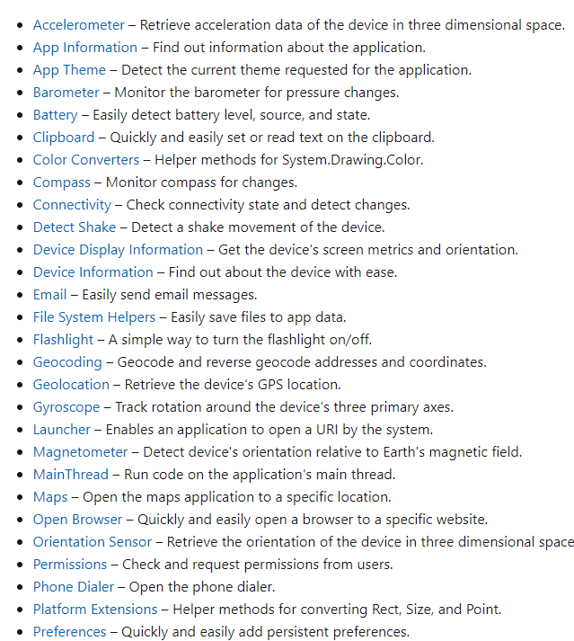
Platform APIs available in Xamarin.Essentials
https://docs.microsoft.com/en-us/xamarin/essentials/

Slide 4
Use Cases
Saving user preferences
and settings
Checking internet connection before doing a web request
Sharing content from the app to other apps
Provide current location
for deliveries

Slide 5
Use Cases
Saving user preferences
and settings
Checking internet connection before doing a web request
Secure Storage API
Connectivity API
Sharing content from the app to other apps
Provide current location
for deliveries
Share API
Geolocation API

Slide 6


Installing the NuGet package
Install on shared code and all platforms
Additional Android Setup

Slide 7
Demo: Trying out some APIs
Text-to-speech, Phone Dialer, Geolocation, and Maps

Slide 8
Xamarin.Forms: Google Map Integration

Slide 9
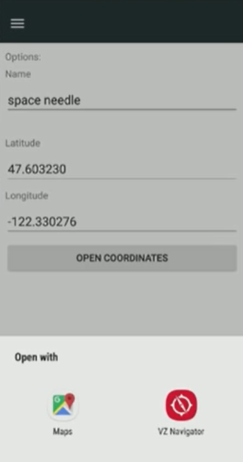
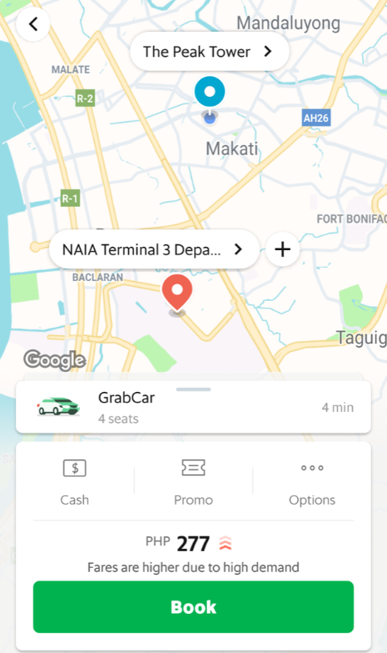
Xamarin.Essentials Map vs Xamarin.Forms.Maps

Slide 10
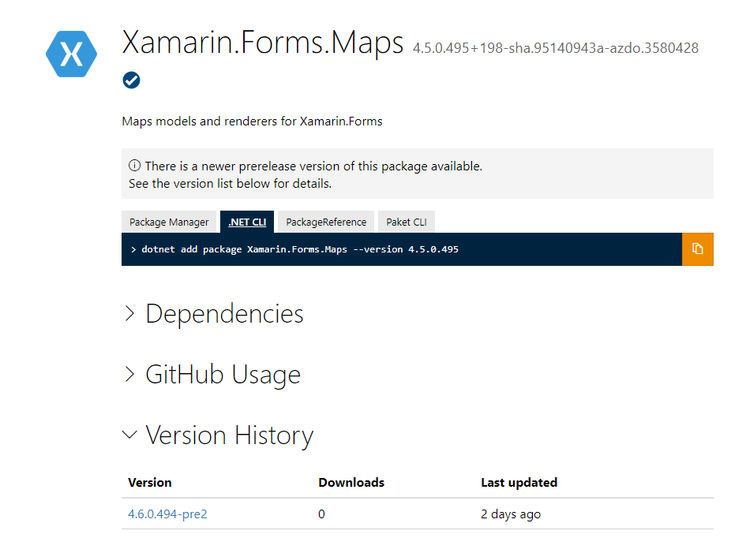
Installing the NuGet package
Install on shared code and all platforms

Slide 11
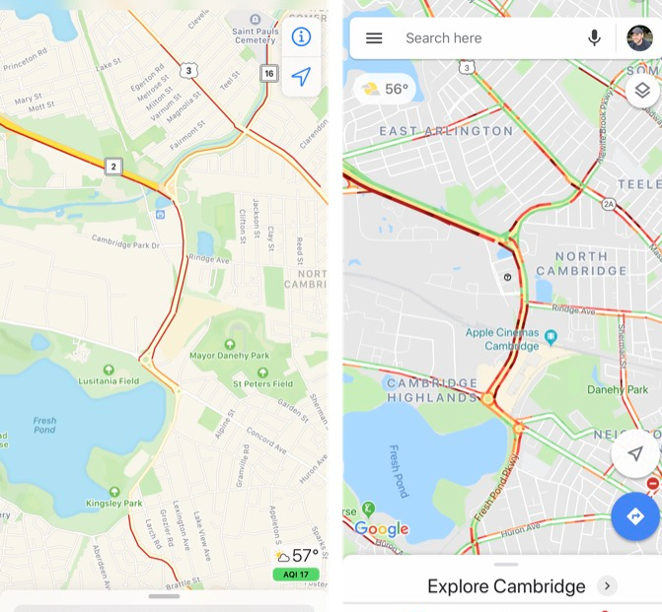
Xamarin.Forms.Maps: Platform-specific maps
Android
iOS

Slide 12
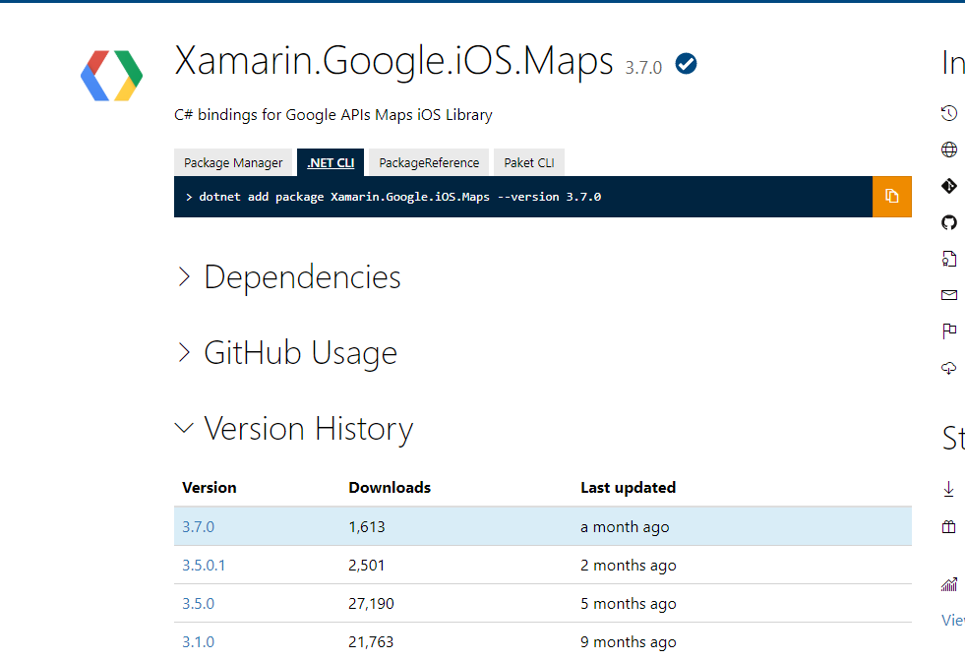
Want Google Map on both platforms?

Slide 13
You need a Google Map API key!

Slide 14

You need a Google Map API key!

Slide 15
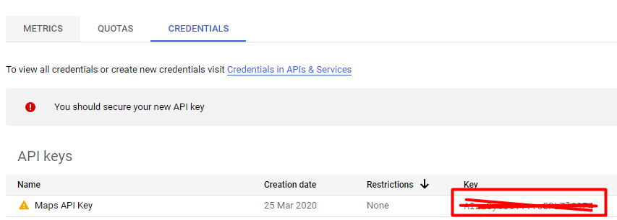
You need a Google Map API key!

Slide 16
Demo: Implementing Google Map
Initialization, Display, and Positioning

Slide 17
Demo: Implementing Google Map
Initialization, Display, and Positioning

Slide 18

Google Map Pins

Slide 19
Demo: Adding Pins
XAML and Dynamic Pins

Slide 20
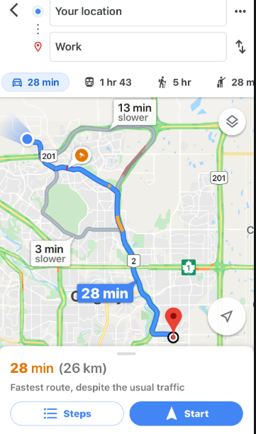
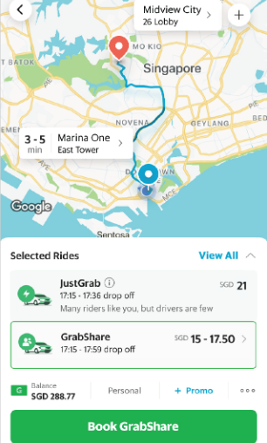
Google Map Directions/Route

Slide 21
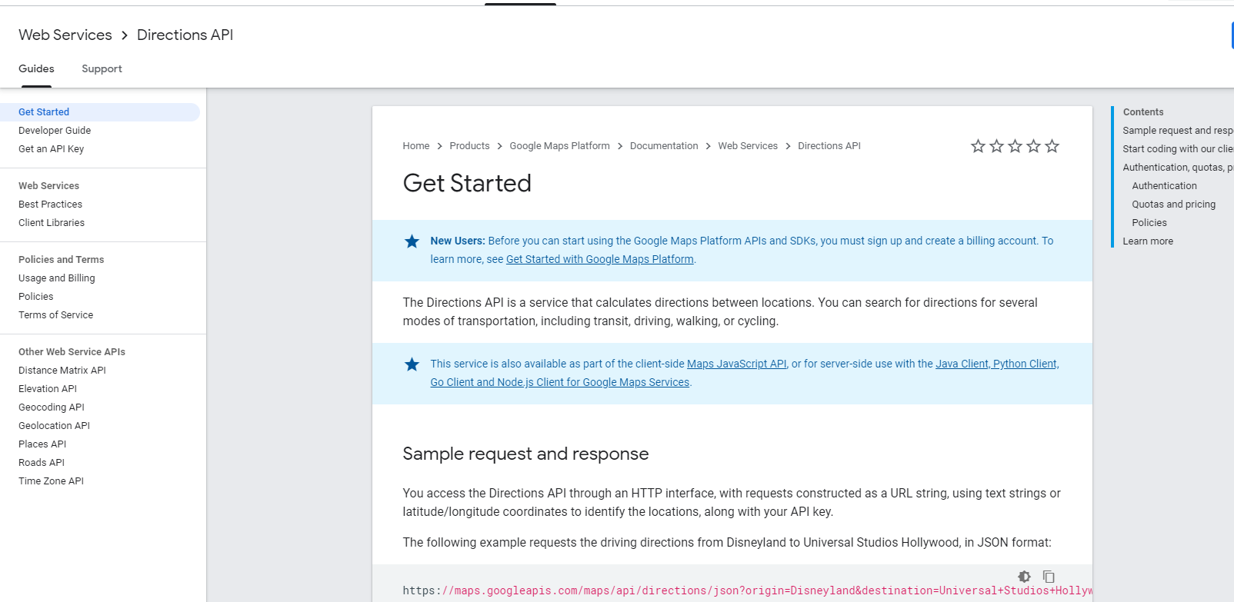
Google Map Directions API

Slide 22
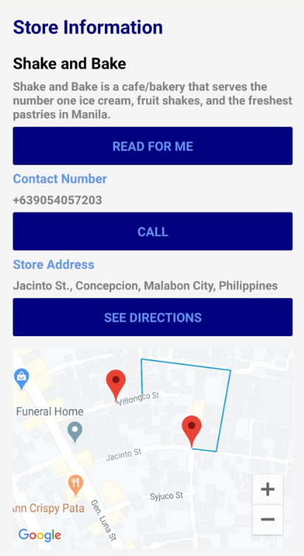
Implementing Polylines and Directions API

Slide 23
Demo: Having fun with Polylines and Direction API
Implementing a scuffed Directions Xamarin.Forms App

Slide 24
Thank you!
Shoot your Questions!
Bryan Anthony Garcia
Microsoft MVP for Developer Technologies

